Slide 1
Data Versioning
Pravin Y Pawar
Adapted from AI Multitude blog

Slide 2
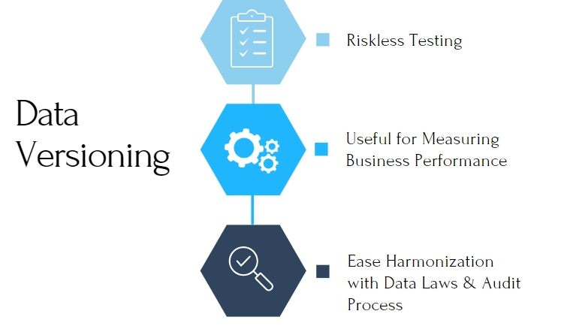
Data Versioning

Slide 3
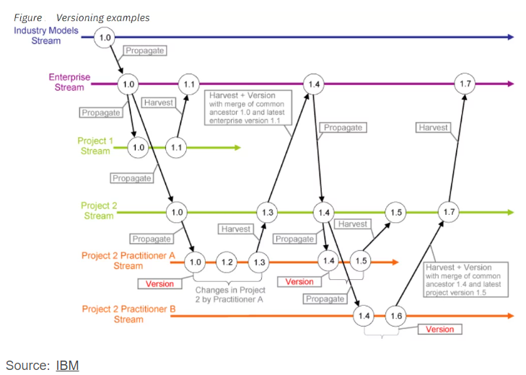
Data Versioning(2)
Data versioning is the storage of different versions of data that were created or changed at specific points in times
Many different reasons for making changes to the data
Data scientists might test the ML models to increase efficiency
therefore make certain changes to the dataset
Datasets can also change over time due to the flow of information
storing older versions of data can help organizations replicate the previous environment

Slide 4
Benefits of data versioning
Old versions of data is saved and kept at the company’s disposal
Preserving the working version while testing
AI/ML models work with the goal of maximizing business efficiency - normal for development teams to test new
ways to increase efficiency
Introducing a new dataset into systems could be one of those exercises
However, in search of the uncertain better, no one wants to risk the previous working version
most of the engineers’ attempts end up as inefficient trials - need to save the previous dataset
If an attempt fails, they simply reload the old working data set into the pipeline, preventing potential loss of
business
Measuring the business performance
Without the intervention of engineers, datasets can change over time - Sales data is changed by each transaction
Storing sales data from different years over a period of time can be insightful for businesses to understand
consumer preferences
Consequently, versioning data can lead to a more profitable business by analyzing changes in customer trends
Compliance and auditing benefits
Data versioning can help with both internal and external audits and compliance processes by ensuring data is
stored from specific times
Some data protection regulations, such as GDPR, force companies to store certain data sources
Data versioning can save companies’ time in meeting such requirements
can also be easier for companies to detect fraud if they have versioned their data

Slide 5
Main formats for data versioning
There is no standard model for data versioning, but there are some common formats that are widely used:
The three-part semantic version number convention
is the most common format for indicating different versions
For example, 3.2.4 indicates a specific data version
The left-hand side number (3) indicates a significant change between data versions
The middle number (2) indicates new features in a compatible manner
and the right-hand side number (4) indicates minor bug fixes compared to older versions
Naming data versions depending on their status
For example, a dataset could be incomplete-complete, filtered-unfiltered, cleaned-uncleaned, etc.
Specifying this information could be helpful for practitioners, especially when they work together on a dataset
via a cloud system
Naming data versions depending upon process
Data version can be named subject to the latest process it is exposed to
For instance, normalized or adjusted according to something etc.

Slide 6
Options for versioning the data
Use file versioning
File versioning
Manually saving versions to computer is one of the options for data versioning
Appropriate for:
Small firms
Small firms with only a few data engineers or scientists working in the same location
Protecting sensitive information
If data contains particularly sensitive information, it should be viewed and interpreted only by a few executives
and data engineers
Individual work
If the task is not suitable for teamwork, where different people cannot work together to achieve a final goal

Slide 7
Options for versioning the data(2)
Using a data versioning tool
Data versioning tool
Specialized tools offer an alternative to file versioning
can either develop own software or outsource it - providers offering such services, such as DVC, Delta
Lake, and Pachyderm
Data versioning tools are more suitable for companies that need:
Real-time editing
If more than one person is working on a dataset, using a specialized tool is more efficient
because file versioning does not allow real-time editing with a group of people
Collaboration from different locations
When people need to collaborate in different locations, using a software is more efficient than file versioning
Accountability
Data versioning software makes it possible to determine in which steps errors occur and who makes the error.
Consequently, the accountability of the team is enhanced

Slide 8
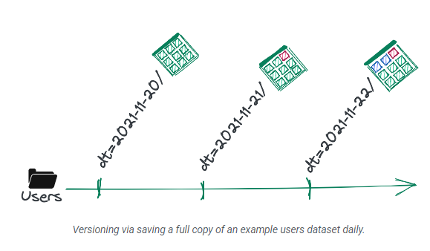
Data Versioning Implementation
Versioning Approach #1: Full Duplication
One option is to save a full copy of it under a new location each time want a version of it
works best for smaller datasets with
something like a daily versioning frequency
does create versioned data, it does so in the
least space-efficient way
code or queries that interact with this versioned data
will be error-prone with the correct date value having to
be manually hardcoded in different places
Although not the most elegant solution, it is an easy
way to get started versioning data

Slide 9
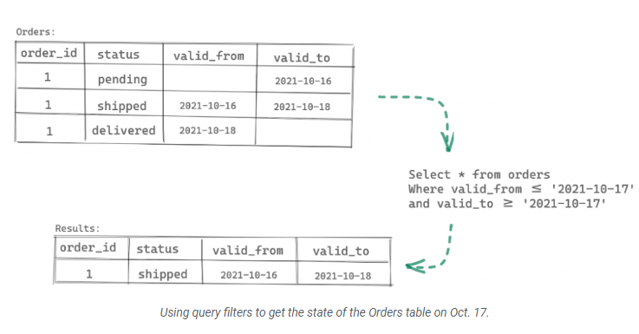
Data Versioning Implementation (2)
Versioning Approach #2: "Valid_from/to" Metadata
A more space-efficient and incremental approach to versioning works by adding and maintaining two metadata fields in a tabular dataset
often named valid_from and valid_to
When updating a record in this dataset, make
sure to never overwrite an existing record
Instead, append new records and update the
valid_to field to the current timestamp for any
record that would have been overwritten
This approach works quite well for “time traveling” throughout a single collection of tabular data
However, it provides only one method of interacting with the versions — which is to add filters to queries on the metadata fields

Slide 10
Data Versioning Implementation (3)
Versioning Approach #3: First-class Data Version Control
First two approaches can be summarized as “Let me add a bit of versioning to the data I already have”
Instead, should think of versioning as a first-class citizen of data environment
An inherent property of any data we introduce into the system
To make this possible - need to solve a few challenges.
Minimize the storage footprint of data versioning
means not creating copies of data objects that remain unchanged between versions
Expose operations that let us interact directly with the versions
Things like “create a version”, “delete a version”, “compare two versions” are examples
Work the same over any scale of data, data format, and both structured and unstructured data
Now, these are not simple problems
And probably won’t hack way to a solution in an afternoon or even a weekend
One of the more popular approaches to solving these extends the git version control model to data
projects like lakeFS, DVC, and git LFS

Slide 11
Challenges to data versioning
Limited storage space
Each versioning of data means that more storage space is required
For companies that produce or use large amounts of data, it would therefore be costly to version the data too often
important for companies to find an optimal balance between the benefits of versioning and the costs incurred by storage
Security issues
Ensuring data security is essential for businesses to protect their reputation
However, as more and more versions of data are stored, the risk of data loss or leakage increases
For cloud users, in particular, this risk is even greater as they simply outsource their IT functions, giving them less control over their data
important for organizations to assess and understand this risk in order to determine an optimal data versioning strategy
Choosing the right provider
If decide to use a data versioning tool, want to choose the most suitable option that meets business requirements
Different cloud providers offer different features and charge different prices
advisable to evaluate the different options in order to ensure cloud cost optimization
Should compare the tools according to the following criteria:
Open source or not
Storage capacity
Has a user friendly interface or not
Support of most common clouds (like AWS) and storage types or not
Cost

Slide 12
Thank You!
In our next session:

